Slide 1



Sandbox Environments
Creating Efficient and Isolated Testing Realms
Victor Bucicovschii
25.11.2023

Slide 2


Agenda
01
Definition and Purpose
05
Update & Maintenance
02
The Process Overview
06
Advantages & Disadvantages
03
Step-by-step Workflow
07
Q&A
04
Lifecycle of the Sandbox

Slide 3
Definition and Purpose

Slide 4
Isolation
Durability
Definition and Purpose
It’s separate from the main system. Think of it like playing in a fenced area; what happens inside won’t get out.
Changes in a sandbox are temporary. Data might be reset or environments might be torn down after testing.
A sandbox environment is a controlled, isolated space specifically designed for testing, development, and experimentation where users can try out new things without causing any trouble elsewhere. It replicates the conditions of the production environment but operates independently of it.
Replication
Flexibility
While it’s isolated, a sandbox often mirrors the production environment. This means it tries to replicate the conditions, configurations, and data of the production system, allowing for accurate testing.
Users can often customize the conditions inside the sandbox. This is especially useful for testing how software behaves under different configurations or conditions.
Temporariness
Learning & Training
Sandboxes are often temporary, meaning they can be created and destroyed as needed. This makes them ideal for short-term tasks like testing a new feature or trying out a new configuration.
For new employees or for testing new technologies, sandboxes offer a safe space to learn and experiment without risks.

Slide 5
The Process Overview

Slide 6
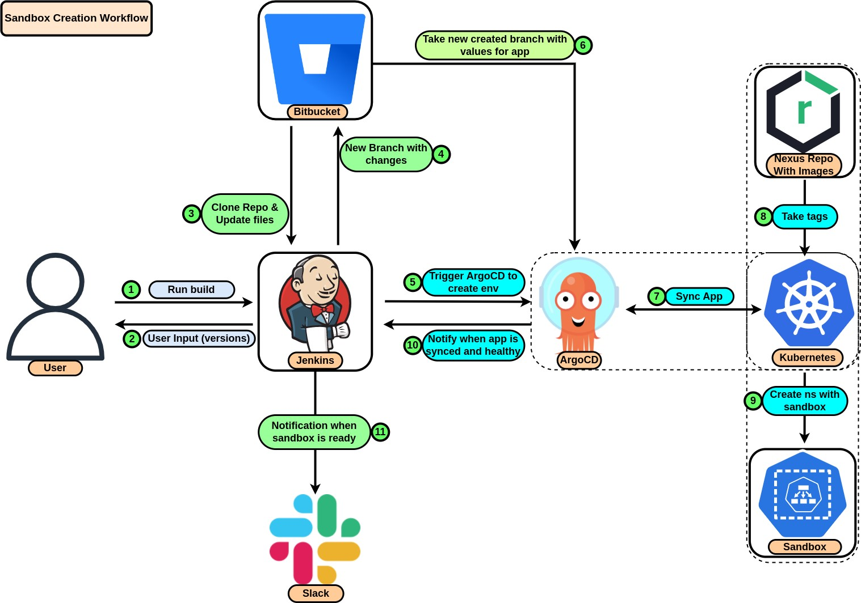
Sandbox Creation Workflow

Slide 7
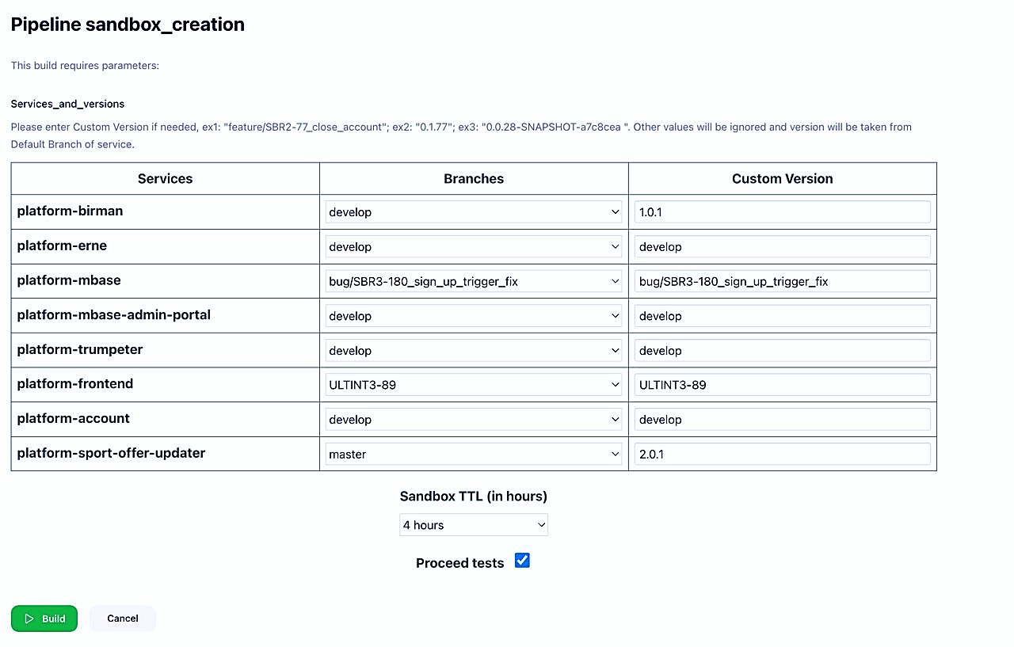

Slide 8
Step-by-step Workflow

Slide 9

Step-by-step
4.
1.
4.
1.
3.
2.
3.
Select Version
SCM checkout
Render User Input
Get versions from branches
Dev choice versions that will be deployed (branch or custom version) and TTL
Clones repo, create new branch starts with user name of creator
The stage validate user input, in case versions isn’t correct – throw exception and send notification in slack
API calls to bitbucket, retrieve service versions from PR
8.
5.
8.
7.
7.
6.
Slack notification
Apply Changes
Push changes
Update ArgoCD manifests
Send notification with sandbox info: TTL, endpoints, service versions, e2e test reports
Create new AppOfApp in k8s cluster, which creates separate namespace with all services and ConfigMap with TTL. It waits services are synced
Push branch with changes to repository
Adding necessary configuration, values, secrets (from jenkins) for Sandbox
* OPTIONAL - E2E tests
If user mark “Proceed tests” – additional job will be added that will run e2e tests that will send slack notification with reports

Slide 10
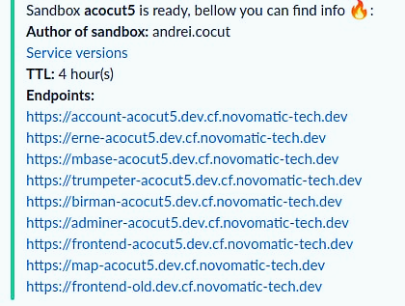
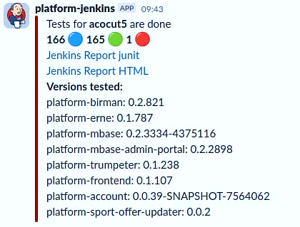

Slide 11
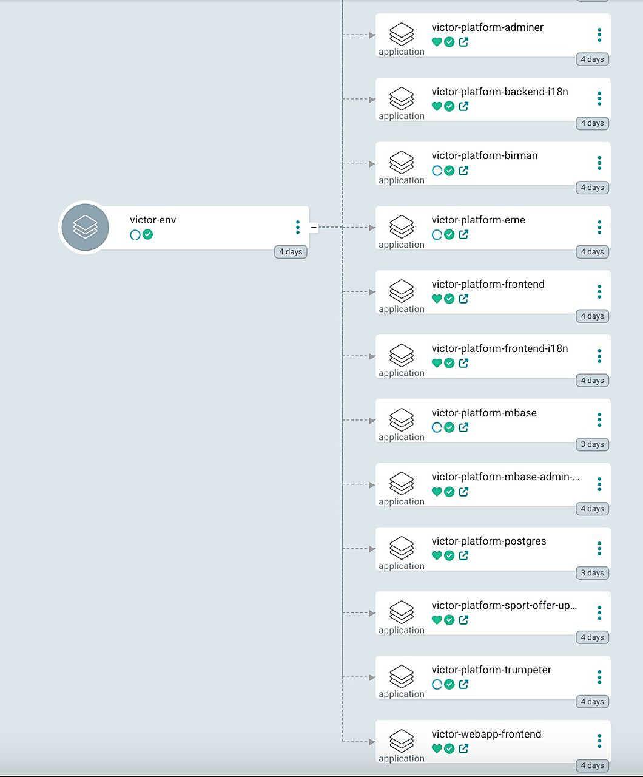
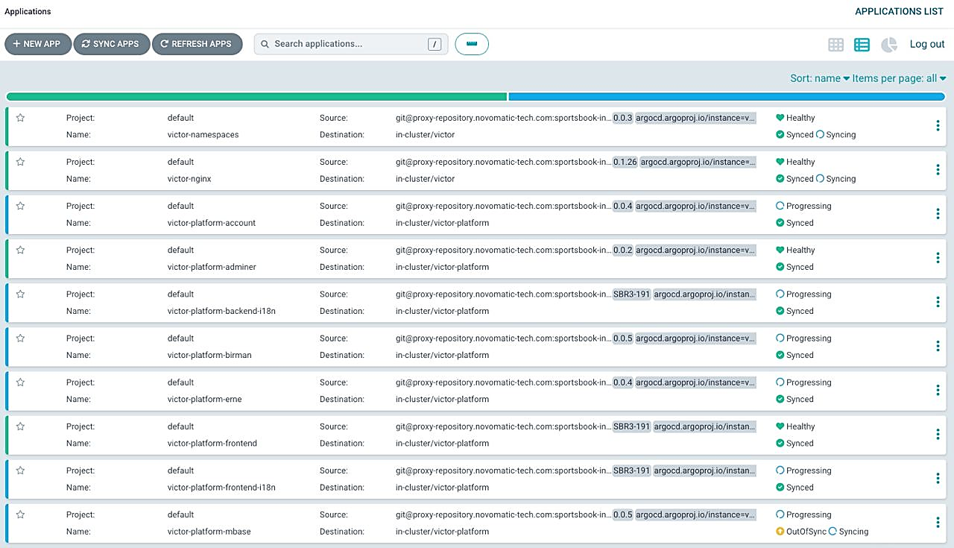

Slide 12
Lifecycle of the Sandbox

Slide 13
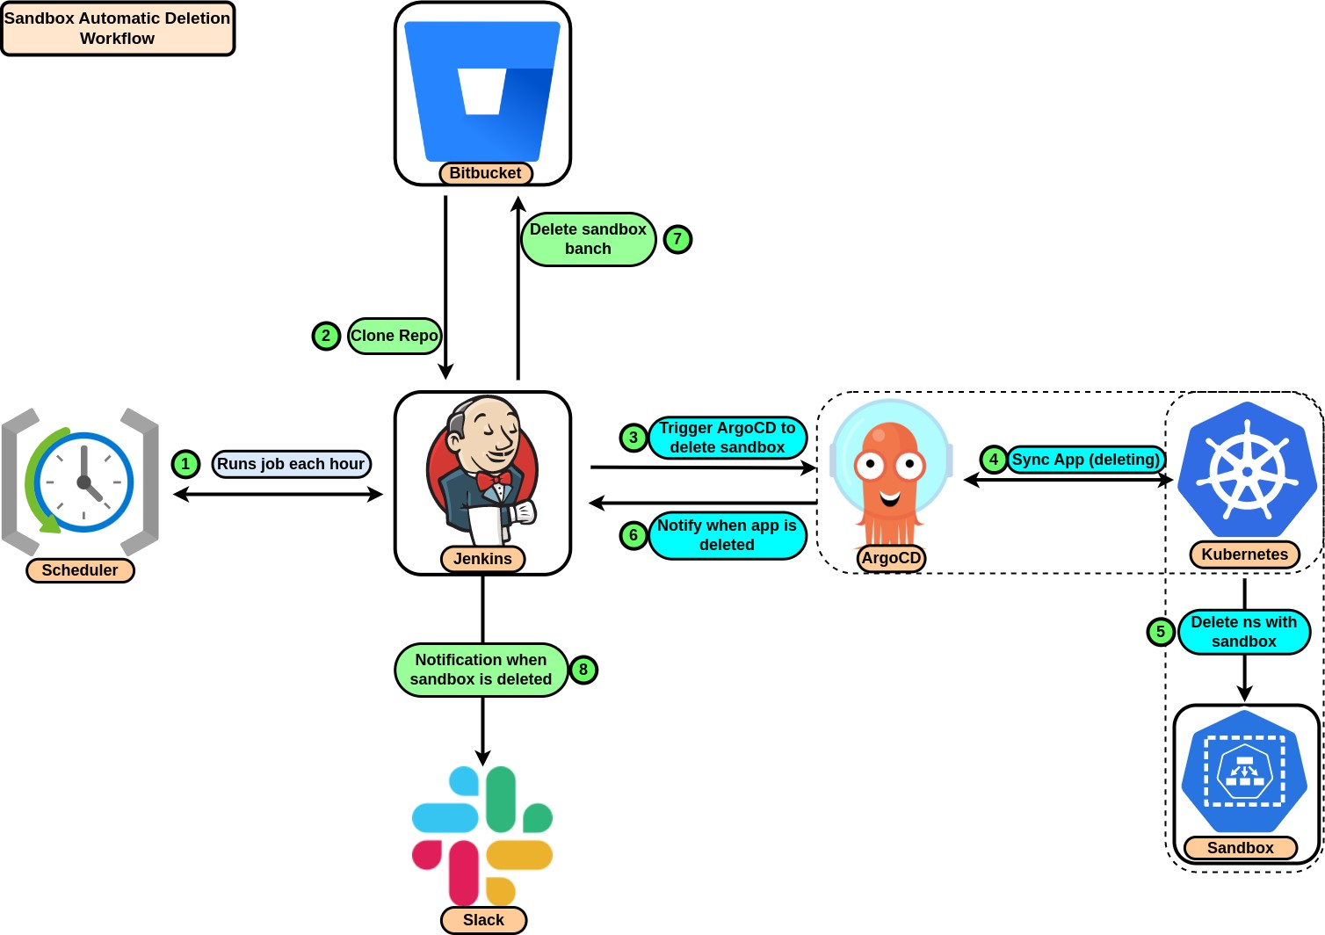
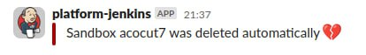
Sandbox Automatic Deletion Workflow
Job runs every hour and checks if there is any sandbox to delete.
Clone repo with ArgoCD configuration
Enter the k8s cluster, checks namespaces that are marked with label “sandbox = true”
Checks the TTL of sandbox and TTL chosen by user, and if it’s greater – trigger deletion process
Deleting sandbox, ArgoCD waits until process is finished and deleting remote branch of this sandbox
Sends notification to slack

Slide 14
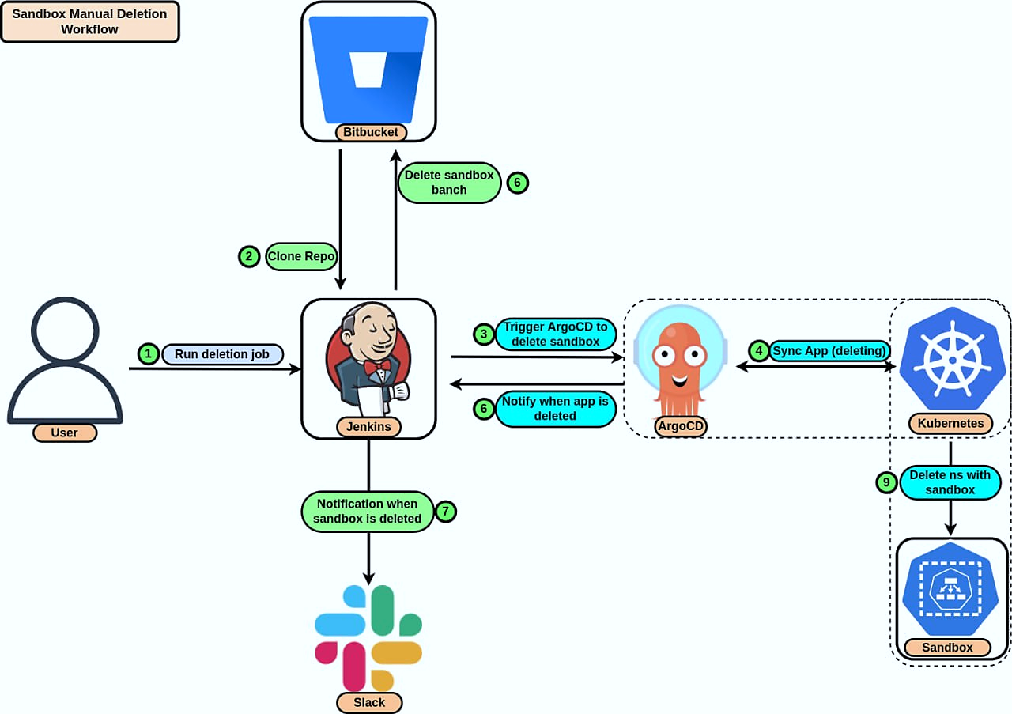
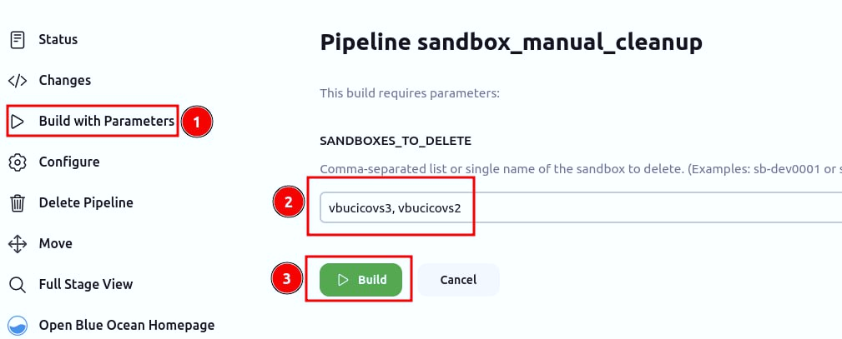
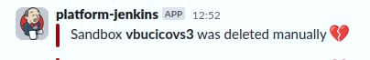
Sandbox Manual Deletion Workflow

Slide 15
Update & Maintenance

Slide 16
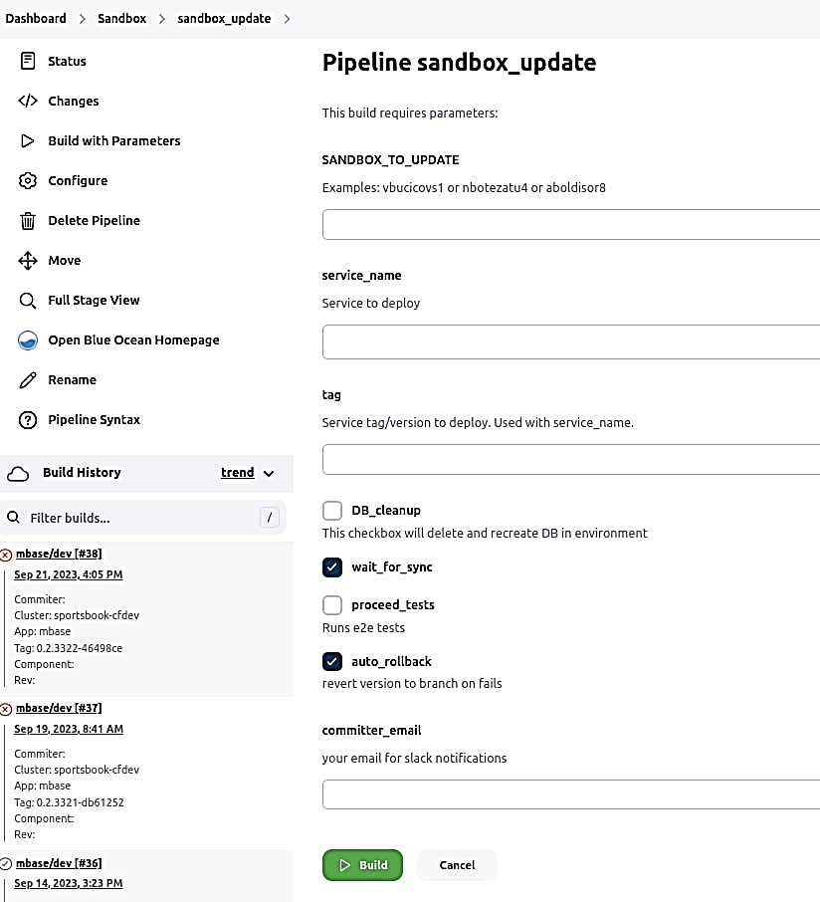
Sandbox Update
Build with Parameters to update sandbox
Selection of sandbox to update
Service and version/tag selection which will be updated
DB cleanup – it will delete current database and create a fresh one without any data
Proceed tests – will run e2e tests for new version if needed
Auto rollback – in case service will fail to sync – it will revert to previous version
Committer email – will send a notification when it’s ready

Slide 17
Advantages & Disadvantages

Slide 18
Advantages
Disadvantages
Environment Consistency: Dynamic sandboxes ensure that every tester or developer works in the same kind of space, reducing the "it works on my machine".​
Parallel Development: Test many things at the same time in different sandboxes make development faster.​
Quick Feedback: Developers can quickly see if their changes work or not in sandboxes. ​
State Reset: If something goes wrong, just reset the sandbox and start fresh.
Training Needed: New team members might need extra time to learn how to use sandboxes effectively.​
Unexpected Errors: Sometimes, weird bugs can pop up in a sandbox but not in the main system, leading to confusion.​
Maintenance: Over time, there will be a need for regular updates and patches for the sandbox environments to keep them up to date.
Complexity in Setup: Require complex setup and configurations in the initial stages (creation of sandbox infrastructure).​

Slide 19
Q&A
Thank you!

